Slide 1
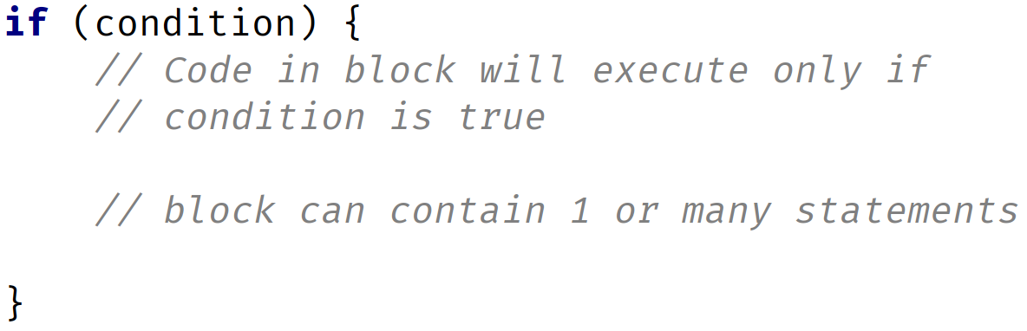

If Then Structure
COMPLETE JAVA MASTERCLASS
Code Blocks And The If Then Else Control Statement

Slide 2
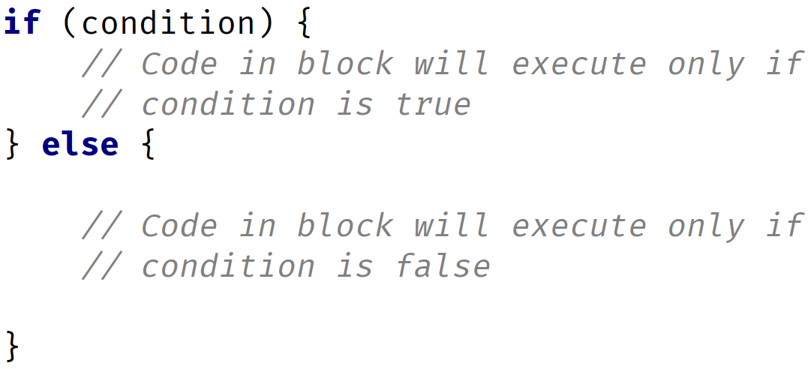
If with an Else block
COMPLETE JAVA MASTERCLASS
Code Blocks And The If Then Else Control Statement

Slide 3
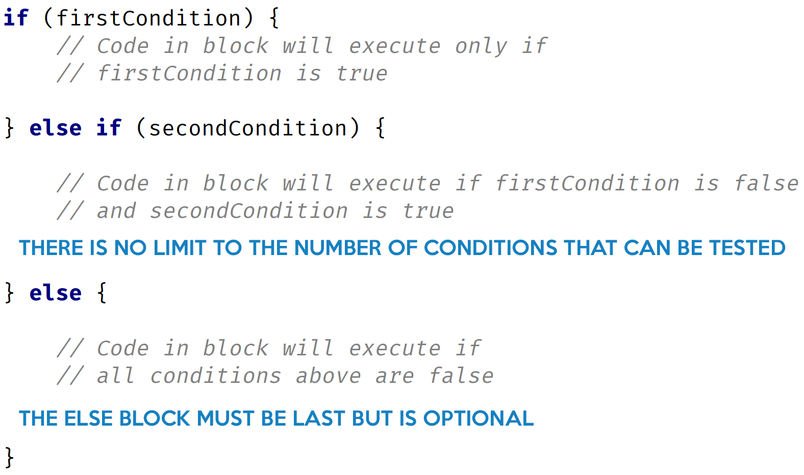
If with an Else if and Else block
COMPLETE JAVA MASTERCLASS
Code Blocks And The If Then Else Control Statement

